Slide 1
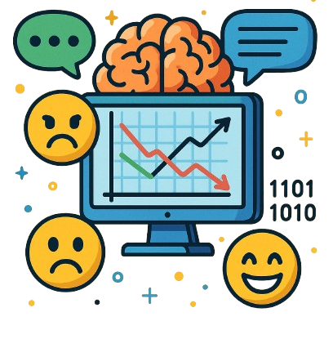
Case Study
Sentiment Analysis NLP Workflow for analyzing
GOV.UK user Feedback Data

Slide 2
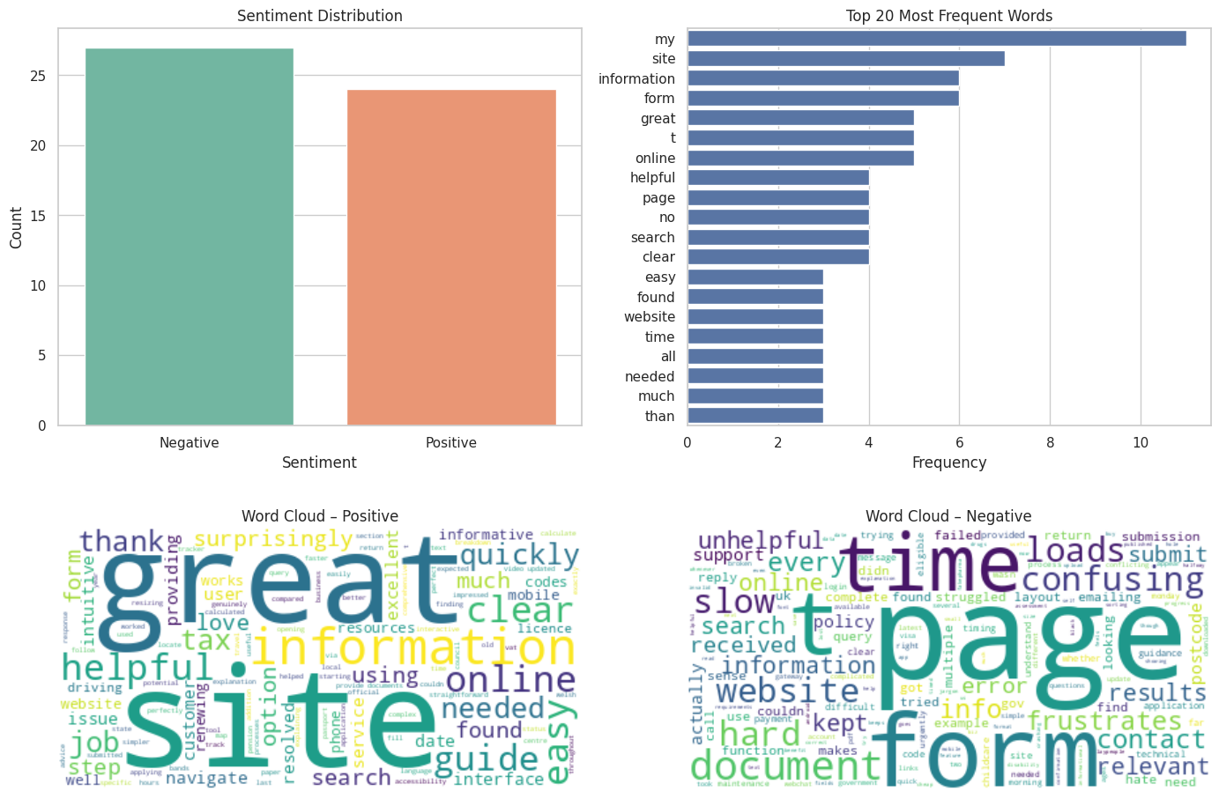
Exploratory Data Analysis

Slide 3
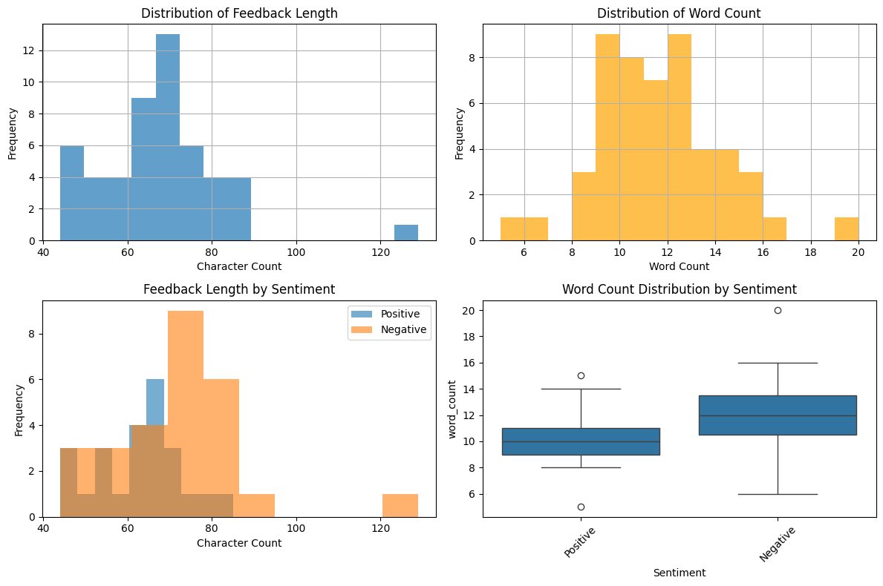
Feedback Length and Word Count Distribution

Slide 4
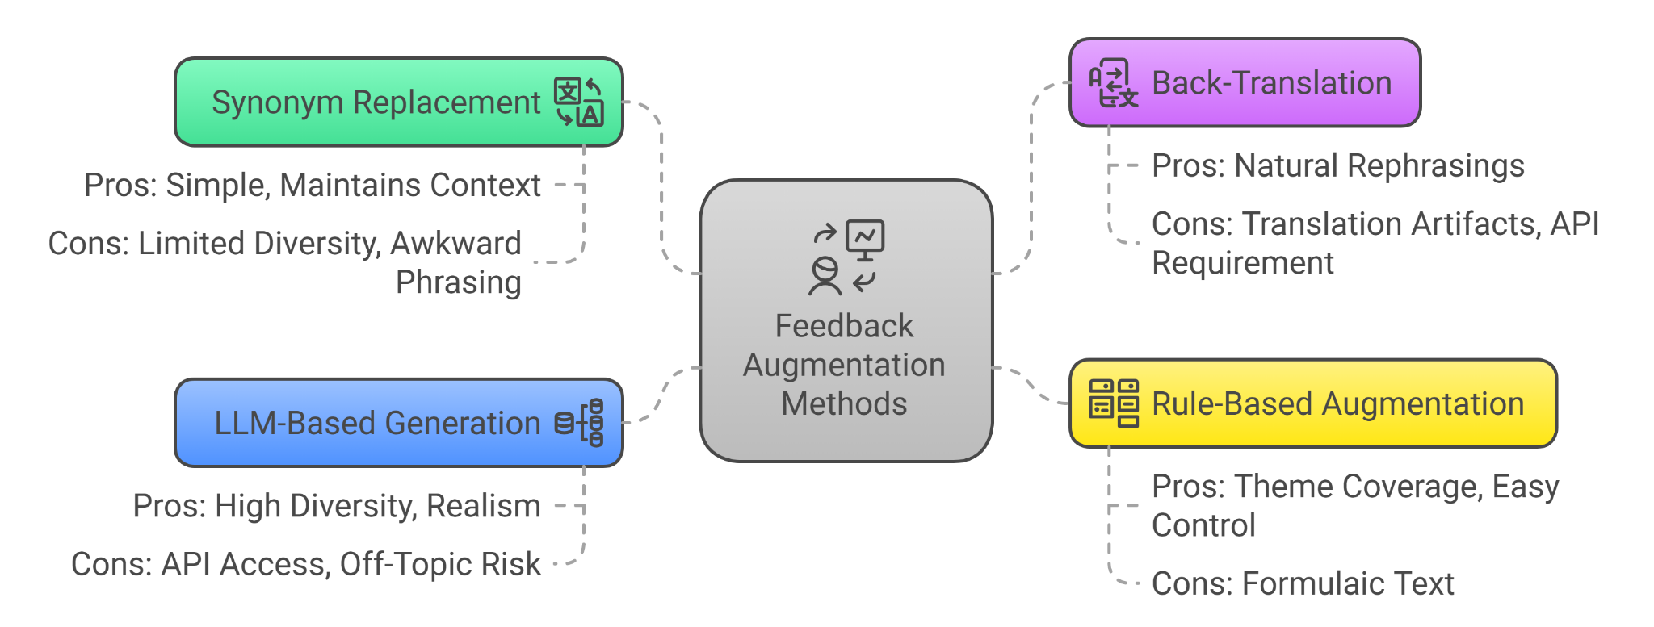
Feedback Augmentation Methods

Slide 5
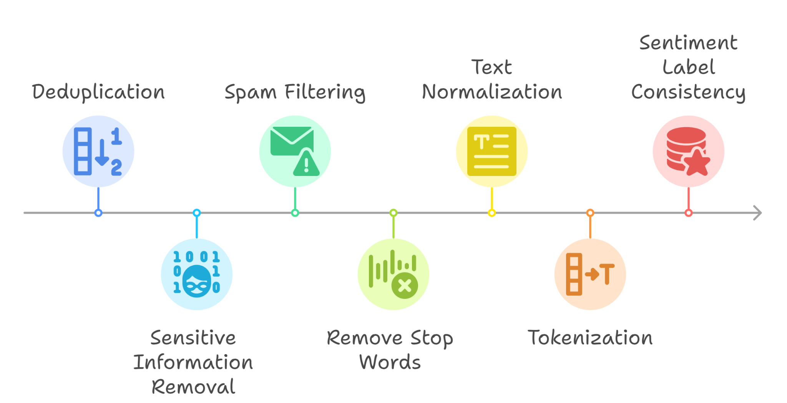
Data Preprocessing steps

Slide 6
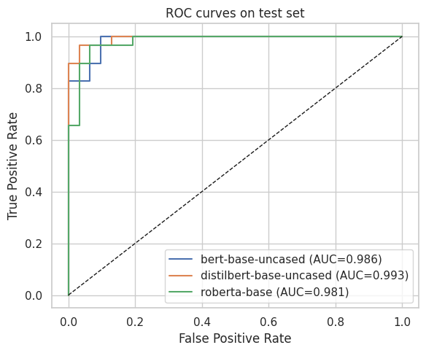
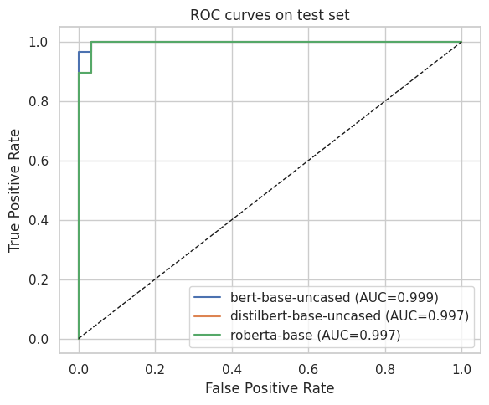
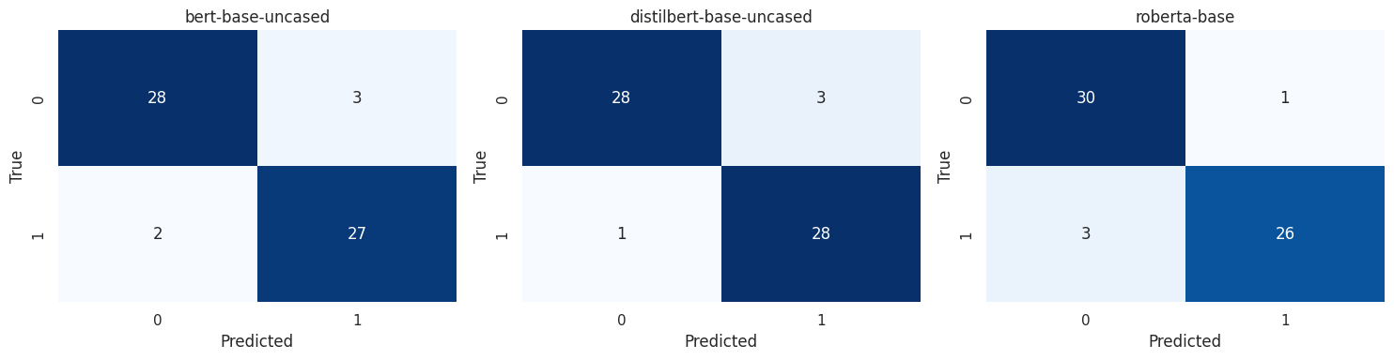
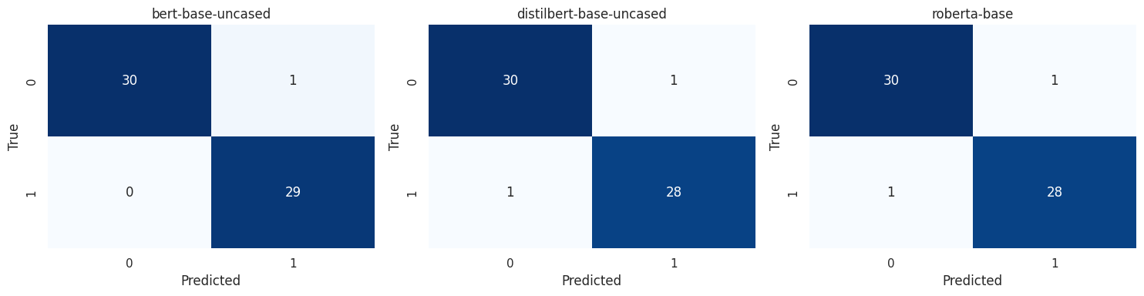
NLPAug vs GPT-4 Augmentation Performance

Slide 7
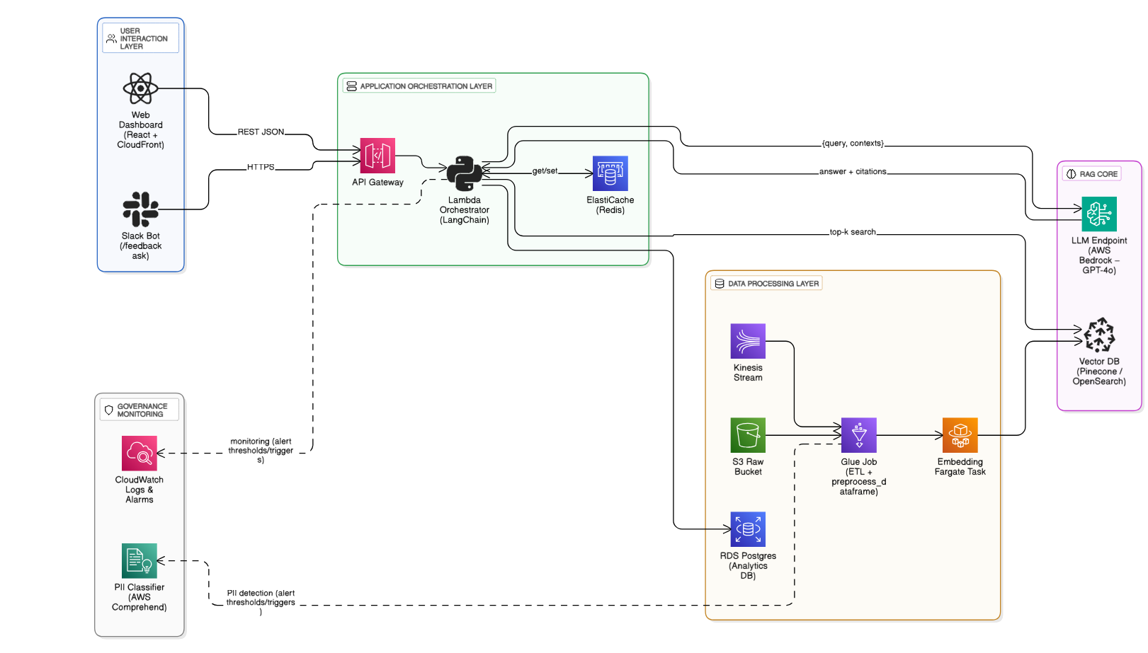
Workflow Architecture

Slide 8
Accuracy & Challenge
Validation Technique
Main Challenge
Mitigations
Measure Model Performance
Small Seed Data
Human-in-the-loop Review
Manual Review Outputs
Data Augmentation Mismatch
Hybrid Search Approach
Q&A Validation
Unusual User Queries
Display Evidence with Answers
LLM Hallucination
Fade out Low Confidence Results
Track User Behavior
Gradual Model Fine-Tuning

Slide 9
Safety & Responsibility
Validation Technique
Main Challenge
Mitigations
Run PII Checks
Sensitive Data
Automatic PII Redaction
Run Bias Checks
Sensitive Topics
Moderation Filters
Red Team Review
Overgeneralization
Show Feedback Count
Require Sufficient Evidence
Access Control

Slide 10
Scalability
Validation Technique
Main Challenge
Mitigations
Simulate Scale
Slow Vector Search
Vector DB with Sharding
Measure Latency and Resource Use
High System Load
Batch Process Feedback
Manual Curation
Partial Index Updates
Stress Test Concurrency
Use Distilled Models
Cold Storage for Old Data

Slide 11
Q&A

